Slide 1

CAPSTONE PROJECT REVIEW III
Prognostic model for Alzheimer's Disease using deep learning based on MRI images
Name : Mohit Kaushik
Programme & Specialization : B.Tech CSE
Guide Name:
Dr. Ilavarasi A K

Slide 2
Outline
Introduction
Problem Statement
Research Objective
Proposed System
Implementation
What is to be done next
Research Paper status
Guide Approval mail snapshot
References

Slide 3
Introduction
Alzheimer’s disease is a brain disorder that slowly destroys memory and thinking skills and, eventually, the ability to carry out the simplest tasks.
According to the statistics , the annual number of new cases of the Alzheimer's disease is anticipated to double by 2050. Therefore, it is very critical to diagnose the individuals with Alzheimer's at an early stage
The disease is named after Dr. Alois Alzheimer. In 1906, Dr. Alzheimer noticed changes in the brain tissue of a woman who had died of an unusual mental illness. Her symptoms included memory loss, language problems, and unpredictable behaviour. After she died, he examined her brain and found many abnormal clumps (now called amyloid plaques) and tangled bundles of fibers.

Slide 4
Introduction
The damage initially takes place in parts of the brain involved in memory, including the entorhinal cortex and hippocampus. It later affects areas in the cerebral cortex, such as those responsible for language, reasoning, and social behaviour. Eventually, many other areas of the brain are damaged.
A prognosis is the forecast or estimation of the risk of something happening in the future. We are interested in predicting a person's future health state using their current characteristics.
Prognostic models are useful tools for doctors, as they provide objective estimates of the probability that something will happen, to use alongside other clinical information.

Slide 5
Problem Statement
The aim of the project is to develop and validate a prognostic model for Alzheimer's Disease using deep learning based on Magnetic Resonance Imaging (MRI) images.
It is a progressive disease beginning with mild memory loss and possibly leading to loss of the ability to carry on a conversation and respond to the environment.
With the help of this model, we are trying to estimate the condition of the people in future based on their today's characteristics.

Slide 6
Research objectives
The objective of this research is to create a prognostic model for the detection of Alzheimer's Disease with the help of deep learning techniques.
This disease is very common nowadays and many models have been built to detect this. But as I have mentioned in my literature survey about their pros and cons, I thought these issues need to be addressed.
Various modelling tools have been devised to assist with the decision-making progress. Some are aimed at predicting a clinical outcome, whereas others focus on identifying patients who may be at risk for the development of a particular condition, so I planned to frame a model that will minimize the cons and will be a great fit for this purpose.

Slide 7
Proposed System (Introduction)
The proposed system is to use Magnetic Resonance Imaging (MRI) images to predict the conversion of patient’s from Mild Cognitive Impairment to Alzheimer’s diseases with the help of their current situation.
To built more realistic model, we will combine structural MRI data with resting state functional MRI data. After combining we use different feature selection algorithm to select the necessary features from the data.
We will categorize the patients into different sub-group based on extracted features and try to predict whether the patient is progressed towards AD or not.

Slide 8
Proposed System (Diagram)
Start
Dataset Collection
Combining all features in one data frame
Data Pre - Processing
Feature Selection using filter and wrapper method
Deep Learning Model
Model Evaluation
End
Feature Extraction

Slide 9
Proposed System (Modules)
These are the modules in the research project:
Data Pre - Processing
Feature Extraction and Selection
Methods

Slide 10
Proposed System (Modules)
Data Pre – Processing
This module is purely focused on cleaning the data. Both the dataset will be pre-processed before training the deep learning model.
Pre-processing techniques like intensity normalization, tissue segmentation, correction of the non-uniformity of image intensity, etc. are performed under this module.
Different atlases are utilized for parcellation in addition to data cleansing since they will aid in understanding the anatomical and functional architecture of the cerebral cortex.

Slide 11
Proposed System (Modules)
Feature Extraction and Selection
In this module, the Principal Component Analysis (PCA) algorithm is used to extract features from both datasets. Then, a single data frame containing all of the retrieved features is assembled.
We will combine filter and wrapper approaches for feature selection. We will use a filter method and sorted feature based on their MRMR (minimum Redundancy Maximum Relevance) score.
Notes:
Filter method – MRMR score
Wrapper method – Sequential Feature Collection (SFC)

Slide 12
Proposed System (Modules)
Method
After selecting features, I will divide the dataset into training and testing data. I will now achieve the final result using a deep learning technique, namely CNN (Convolution Neural Network).
After determining the features, I will employ the stack-ensemble approach in addition to the deep learning algorithm. Finally, the accuracy of both algorithms will be compared, and the best model will be selected.
Notes:
Filter method – MRMR score
Wrapper method – Sequential Feature Collection (SFC)

Slide 13
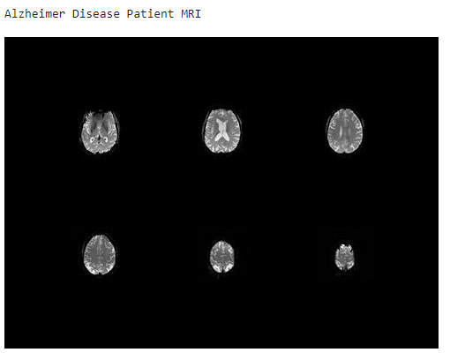
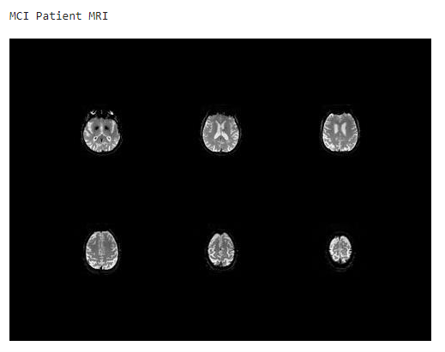
Implementation
So far I have classified the Alzheimer’s Disease with the help of machine learning algorithm's.

Slide 14
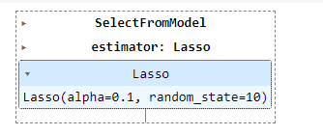

Implementation
In this work, we have selected two different algorithms for feature selection.
Lasso regression
This model uses shrinkage. Shrinkage is where data values are shrunk towards a central point as the mean
Principal component analysis (PCA)
It is used to reduce the number of dimensions with the help of identifying relationships within a set of variables.

Slide 15
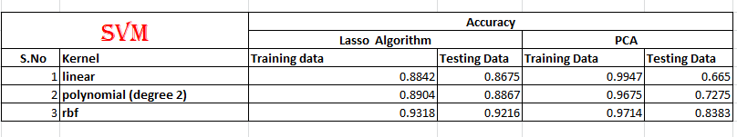
Implementation
The first machine learning algorithm which is used for identifying the patient with MCI or AD is Support Vector Machine (SVM) which is trained with features selected by both the algorithms and their results are compared.
“rbf” kernel performs best among the given kernels with both the feature selection algorithms.

Slide 16
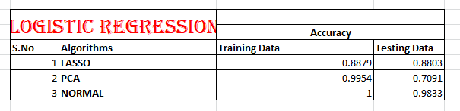
Implementation
Logistic regression estimates the probability of an event occurring, based on a given dataset of independent variables
Equation –
y = e^(b0 + b1X)/ (1+ e^(b0 + b1X))
here,
x = input value
y = predicted output
b0 = bias or intercept term
b1 = coefficient for input (x)

Slide 17
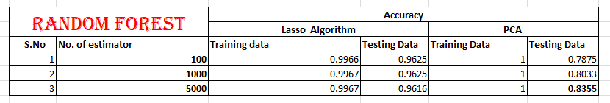
Implementation
Random Forest is a classifier that contains a number of decision trees on various subsets of the given dataset and takes the average to improve the predictive accuracy of that dataset.
LASSO feature selection algorithms perform best with 1000 decision tree while PCA performs best with 5000 decision trees.

Slide 18
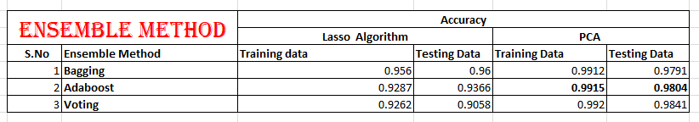
Implementation
It is a process in which multiple machine learning models (such as classifiers) are strategically constructed to solve a particular problem.
Here we use three ensemble techniques – Bagging, Adaboost and Voting Ensemble.
From the above result we can state that Voting Ensemble perform best with Principal Component Analysis and yield an accuracy of 98.4%.

Slide 19
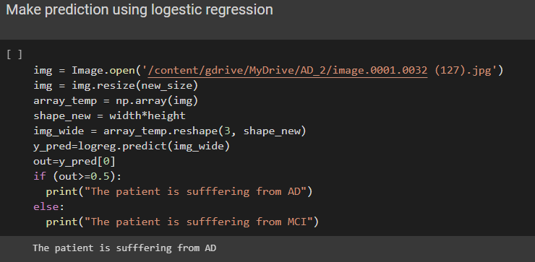
Implementation
Prediction of the patient using MRI Image

Slide 20
What is to do be done next?
The machine learning algorithms which I have implemented gives me a good accuracy but also facing over-fitting issue, so by nest review I want to resolve it and keep my models error free.
Deep learning plays a vital role in the classification of disease, so my next target is to classify the disease with the help of deep learning algorithm and compare the accuracy of both the algorithms.
Updation of the results in the research paper.

Slide 21
Research Paper Status
I have updated the methodology in paper since review 2.
As I progress with the actual implementation I will be updating the results and conclusion.

Slide 22
References
[1] Loddo, A., Buttau, S. and Di Ruberto, C., 2022. Deep learning based pipelines for Alzheimer's disease diagnosis: a comparative study and a novel deep-ensemble method. Computers in Biology and Medicine, 141, p.105032
[2] Buyrukoğlu, S., 2021, September. Improvement of machine learning models’ performances based on ensemble learning for the detection of Alzheimer disease. In 2021 6th International Conference on Computer Science and Engineering (UBMK) (pp. 102-106). IEEE.
[3] Suk, H.I. and Shen, D., 2016, October. Deep ensemble sparse regression network for Alzheimer’s disease diagnosis. In International Workshop on Machine Learning in Medical Imaging (pp. 113-121). Springer, Cham.
[4] Grassi, M., Rouleaux, N., Caldirola, D., Loewenstein, D., Schruers, K., Perna, G., Dumontier, M. and Alzheimer's Disease Neuroimaging Initiative, 2019. A novel ensemble-based machine learning algorithm to predict the conversion from mild cognitive impairme
[5] Tanveer, M., Rashid, A.H., Ganaie, M.A., Reza, M., Razzak, I. and Hua, K.L., 2021. Classification of Alzheimer’s disease using ensemble of deep neural networks trained through transfer learning. IEEE Journal of Biomedical and Health Informatics, 26(4), pp.1453-1463.
[6] Islam, J. and Zhang, Y., 2018. Brain MRI analysis for Alzheimer’s disease diagnosis using an ensemble system of deep convolutional neural networks. Brain informatics, 5(2), pp.1-14.

Slide 23
References
[7] Khoei, T.T., Labuhn, M.C., Caleb, T.D., Hu, W.C. and Kaabouch, N., 2021, May. A Stacking-based Ensemble Learning Model with Genetic Algorithm For detecting Early Stages of Alzheimer’s Disease. In 2021 IEEE International Conference on Electro Information Technology (EIT) (pp. 215-222). IEEE.
[8] Bhagwat, N., Pipitone, J., Voineskos, A.N., Chakravarty, M.M. and Alzheimer’s Disease Neuroimaging Initiative, 2019. An artificial neural network model for clinical score prediction in Alzheimer disease using structural neuroimaging measures. Journal of Psychiatry and Neuroscience, 44(4), pp.246-260.
[9] Kim, M., Kim, J., Qu, J., Huang, H., Long, Q., Sohn, K.A., Kim, D. and Shen, L., 2021, December. Interpretable temporal graph neural network for prognostic prediction of Alzheimer’s disease using longitudinal neuroimaging data. In 2021 IEEE International Conference on Bioinformatics and Biomedicine (BIBM) (pp. 1381-1384). IEEE.
[10] Agarwal, D., Marques, G., de la Torre-Díez, I., Franco Martin, M.A., García Zapiraín, B. and Martín Rodríguez, F., 2021. Transfer learning for Alzheimer’s disease through neuroimaging biomarkers: a systematic review. Sensors, 21(21), p.7259
[11] Ramzan, F., Khan, M.U.G., Rehmat, A., Iqbal, S., Saba, T., Rehman, A. and Mehmood, Z., 2020. A deep learning approach for automated diagnosis and multi-class classification of Alzheimer’s disease stages using resting-state fMRI and residual neural networks. Journal of medical systems, 44(2), pp.1-16.

Slide 24
Thank You

